Slide 1

Challenge:
The Incredible Machine

Slide 2

Teacher Summary
TASK: Build a network of robots that pass LEGO balls between each other without human assistance.
DURATION: A simple design will take a single 2-hour class. A more complex design will stretch over 3-4 classes.
Objectives:
Learn how to work on individual tasks within an overall group project.
Discover Simple Machines.
Equipment: This activity requires 4-20 MINDSTORMS® kits (EV3, NXT, Education or Retail) and a supply of LEGO® balls.
Students: 1-2 students build robot, limited to the contents of the set from which they are working.

Slide 3
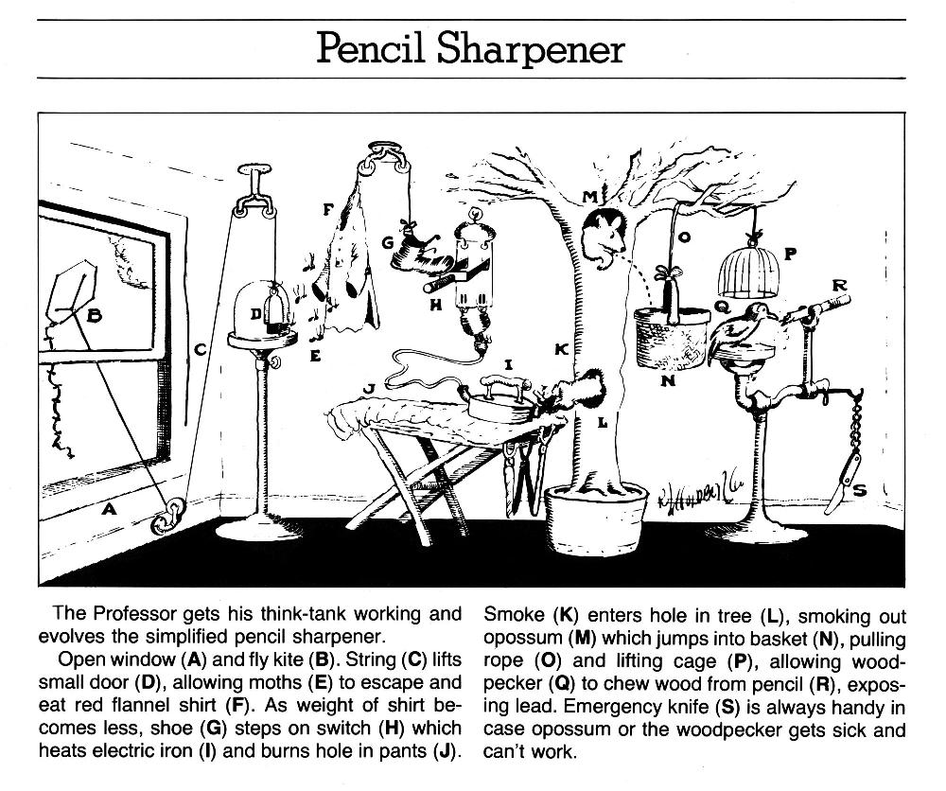

Incredible Machine
Rube Goldberg TM & © of Rube Goldberg, Inc. Distributed by United Feature Syndicate, Inc.

Slide 4
Incredible Machine - Goals
Build a network of robots that take LEGO balls and pass them between each other without human assistance.
Robots should “connect” to various framework pieces that have already been designed. These pieces will be locked into place and can be modified if needed.
Each robot should use at least one over-complicated method to move the LEGO balls. Gravity doesn’t count!
The main goal is to have a steady stream of balls moving through the chain. It doesn’t have to be a complete chain – there can be a beginning and an end.

Slide 5
Incredible Machine – Design Rules
Each individual robot is to consist of these elements:
Link: Robots form a machine by working with other robots in the network. This can be done through connecting framework, or robot to robot.
Entry: Where balls are received from the sender
Exit: Where balls are sent to the receiver.
Sensors: Robots must use sensors to detect the arrival of a ball.
Mechanism: Robots must have at least one mechanism for moving balls when they are received. Each mechanism must depend on at least one motor to make the balls move.
Complexity: Each robot must incorporate a complex machine (2+ Simple Machines) or complicated design. Simple methods are allowed once this is done!

Slide 6
Incredible Machine - Setup
Begin by placing MINDSTORMS bricks within a set formation decided by the class. A simple circle or square is fine (although a little boring).
Advanced Only: Be creative! Go up and down tables, or try and bridge open distances.
MINDSTORMS Bricks should be spaced between frameworks. Use A4 sheets of paper to mark locations.
Use the formation to define the “sender” and “receiver” locations for each robot.
Each team is to discuss the angle and direction of the links sending and receiving the LEGO Ball between robots.
Note the team(s) on either side of you!

Slide 7
Incredible Machine - Setup
Template Design Example
Height = 10 Studs
Jack and Fred
To Jane and Sarah
From Rahul and Elisha
Height = 15 Studs

Slide 8
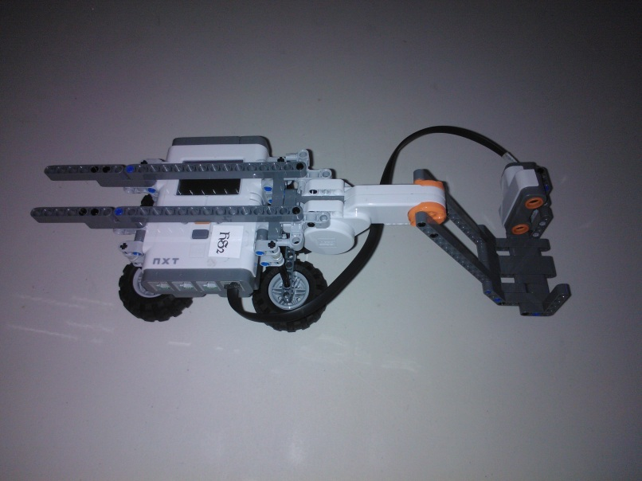
Incredible Machine - Rules
You don’t have to physically connect the different robots to each other or the framework.
Robots cannot move from their starting position in the network.
No robot can hold a ball motionless for more than 5 seconds.
Balls cannot touch each other while in the machine.
No human intervention is allowed once the ball is in motion.
Project Bucephalus (2012)

Slide 9
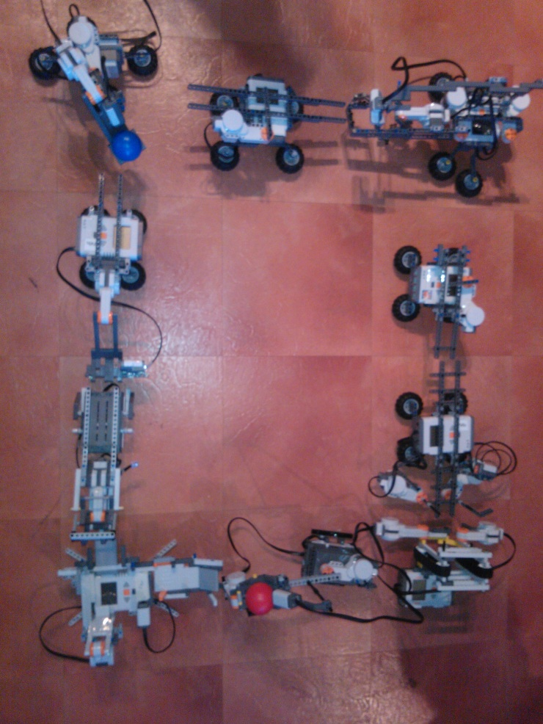
Incredible Machine – Design Notes
Balls roll downhill – but at least one robot in the machine will need to “lift” the ball.
How many balls can your robot “juggle” before passing them on?
How do you prevent ball collisions?
Build a stable base to prevent your robot from moving.
Test sensors to find the best ball detectors.
Keep talking to your linking robot owners to make sure your robots can connect!
Project Bucephalus (2012)

Slide 10
Incredible Machine – Advanced
Feeling Advanced?
Build a machine to keep multiple balls active at once.
Earn bonus points by raising the ball as high as possible.
Build Multiple paths through your machine.
Build a “shortcut” to another machine with multiple paths!
Design a complex program to eliminate error.
Make creative use of lights, sounds, and display to make your machine interesting to watch.

Slide 11
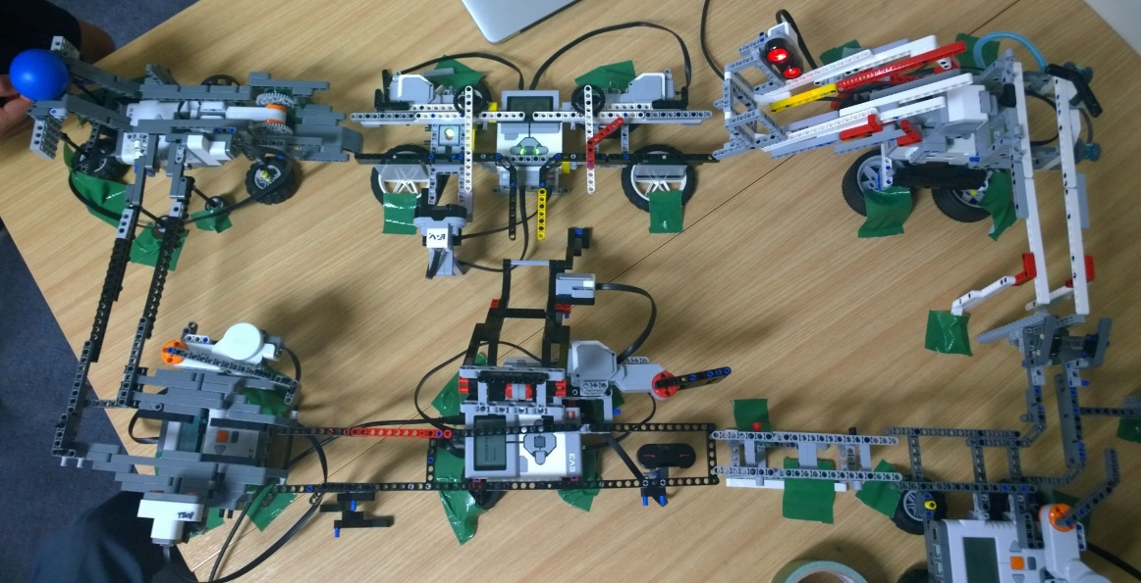
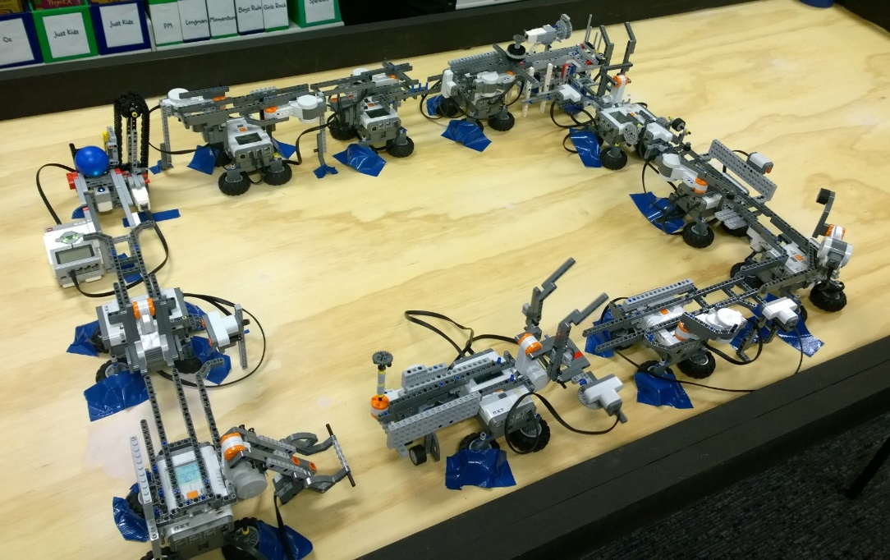
Incredible Machine – Examples
Watch the Incredible Machine here: https://www.youtube.com/watch?v=_v5IPvth_gE

